Slide 1

Making Apps More Human
AN INTRO TO MICROSOFT’S COGNITIVE SERVICES
Matthew Soucoup
PRINCIPAL
@codemillmatt codemilltech.com
https://bit.ly/that-cog
Headshot optional
Notes:
Talk about music at Kalahari interest – action movie hero – then ok to turn it off

Slide 2


Slide 3

Notes:
¡

Slide 4

Unfamiliar places…

Slide 5

Different languages…

Slide 6
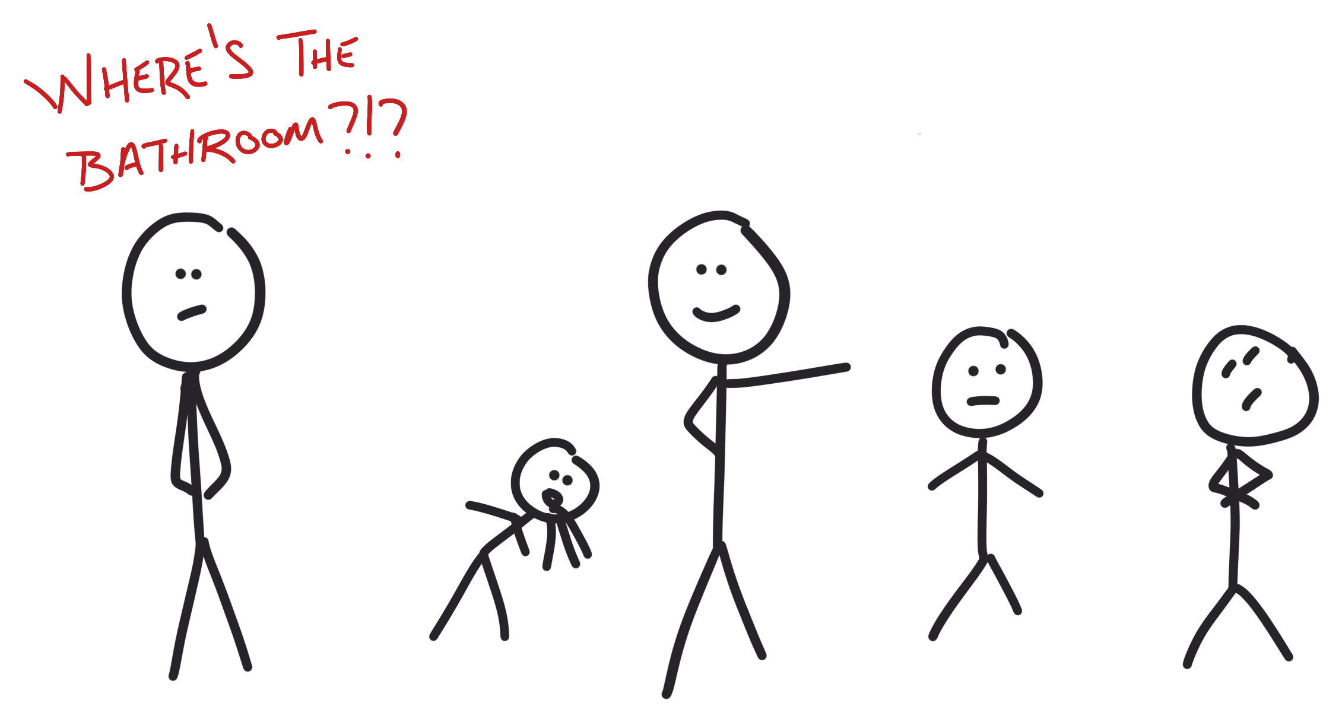
Who to ask questions to…

Slide 7

An app … that can be human?

Slide 8

Microsoft Cognitive Services

Slide 9
Cognitive Services - REST APIs
Hosted in Azure
Machine Learning
Vision
Speech
Language
Knowledge
Search

Slide 10







Vision
Content Moderator
Emotion
Video Indexer
Video API
Computer Vision
Face API
Custom Vision Service
Notes:
Computer vision
Content moderator
Video API
Video Indexer
Face API
Emotion API
Custom Vision Service

Slide 11




Speech
Bing Speech API
Custom Speech Service
Speaker Recognition
Translator API
Notes:
Translator
Bing
Recognition
Custom service

Slide 12






Language
Language Understanding
Web Language Model
Translator API
Text Analytics API
Bing Spell Check
Linguistics Analysis
Notes:
LUIS -> Brewers score
Spell check
Language model
Text analytics
Translator
Lingustics analysis

Slide 13






Knowledge
QnA
Explorations
Recommendations API
Academic Knowledge API
Entity Linking
Custom Decision
Notes:
Recommendations
Explorations
Entity Linking
Academic
QnA
Custom decision

Slide 14







Search
Bing News API
Entity
Search API
Bing Autosuggest API
Video API
Custom Search API
Image API
Notes:
Autosuggest
News
Web
Entity
Image
Video
Custom

Slide 15

The Vacation Itinerary…

Slide 16
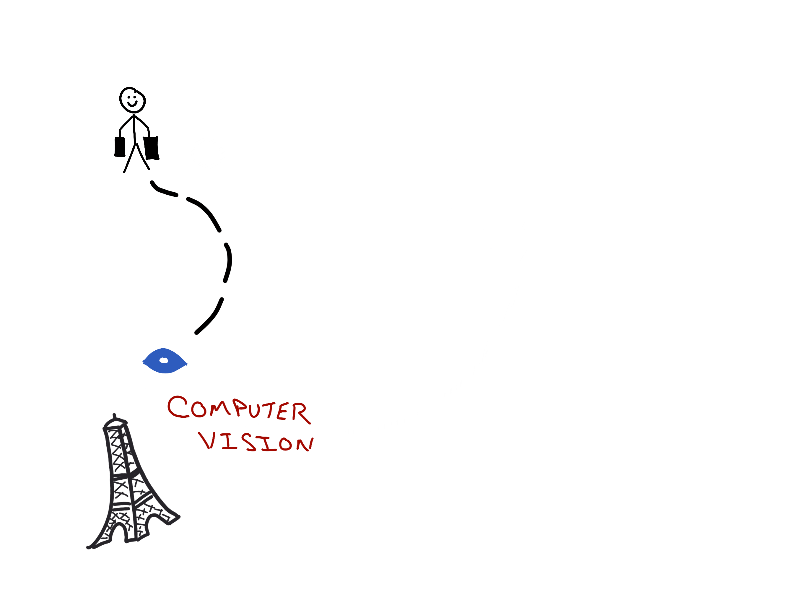
The Vacation Itinerary…

Slide 17
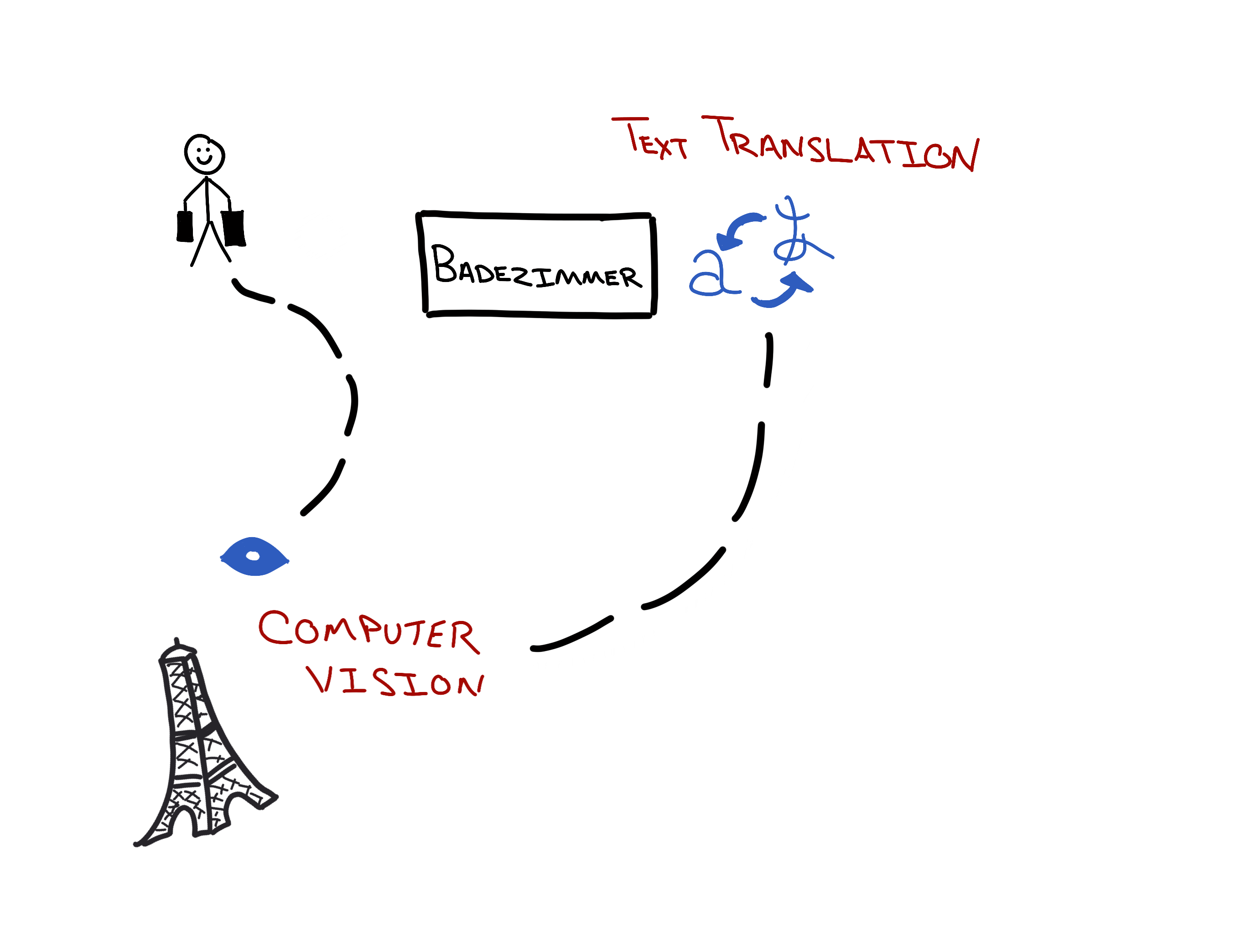
The Vacation Itinerary…

Slide 18
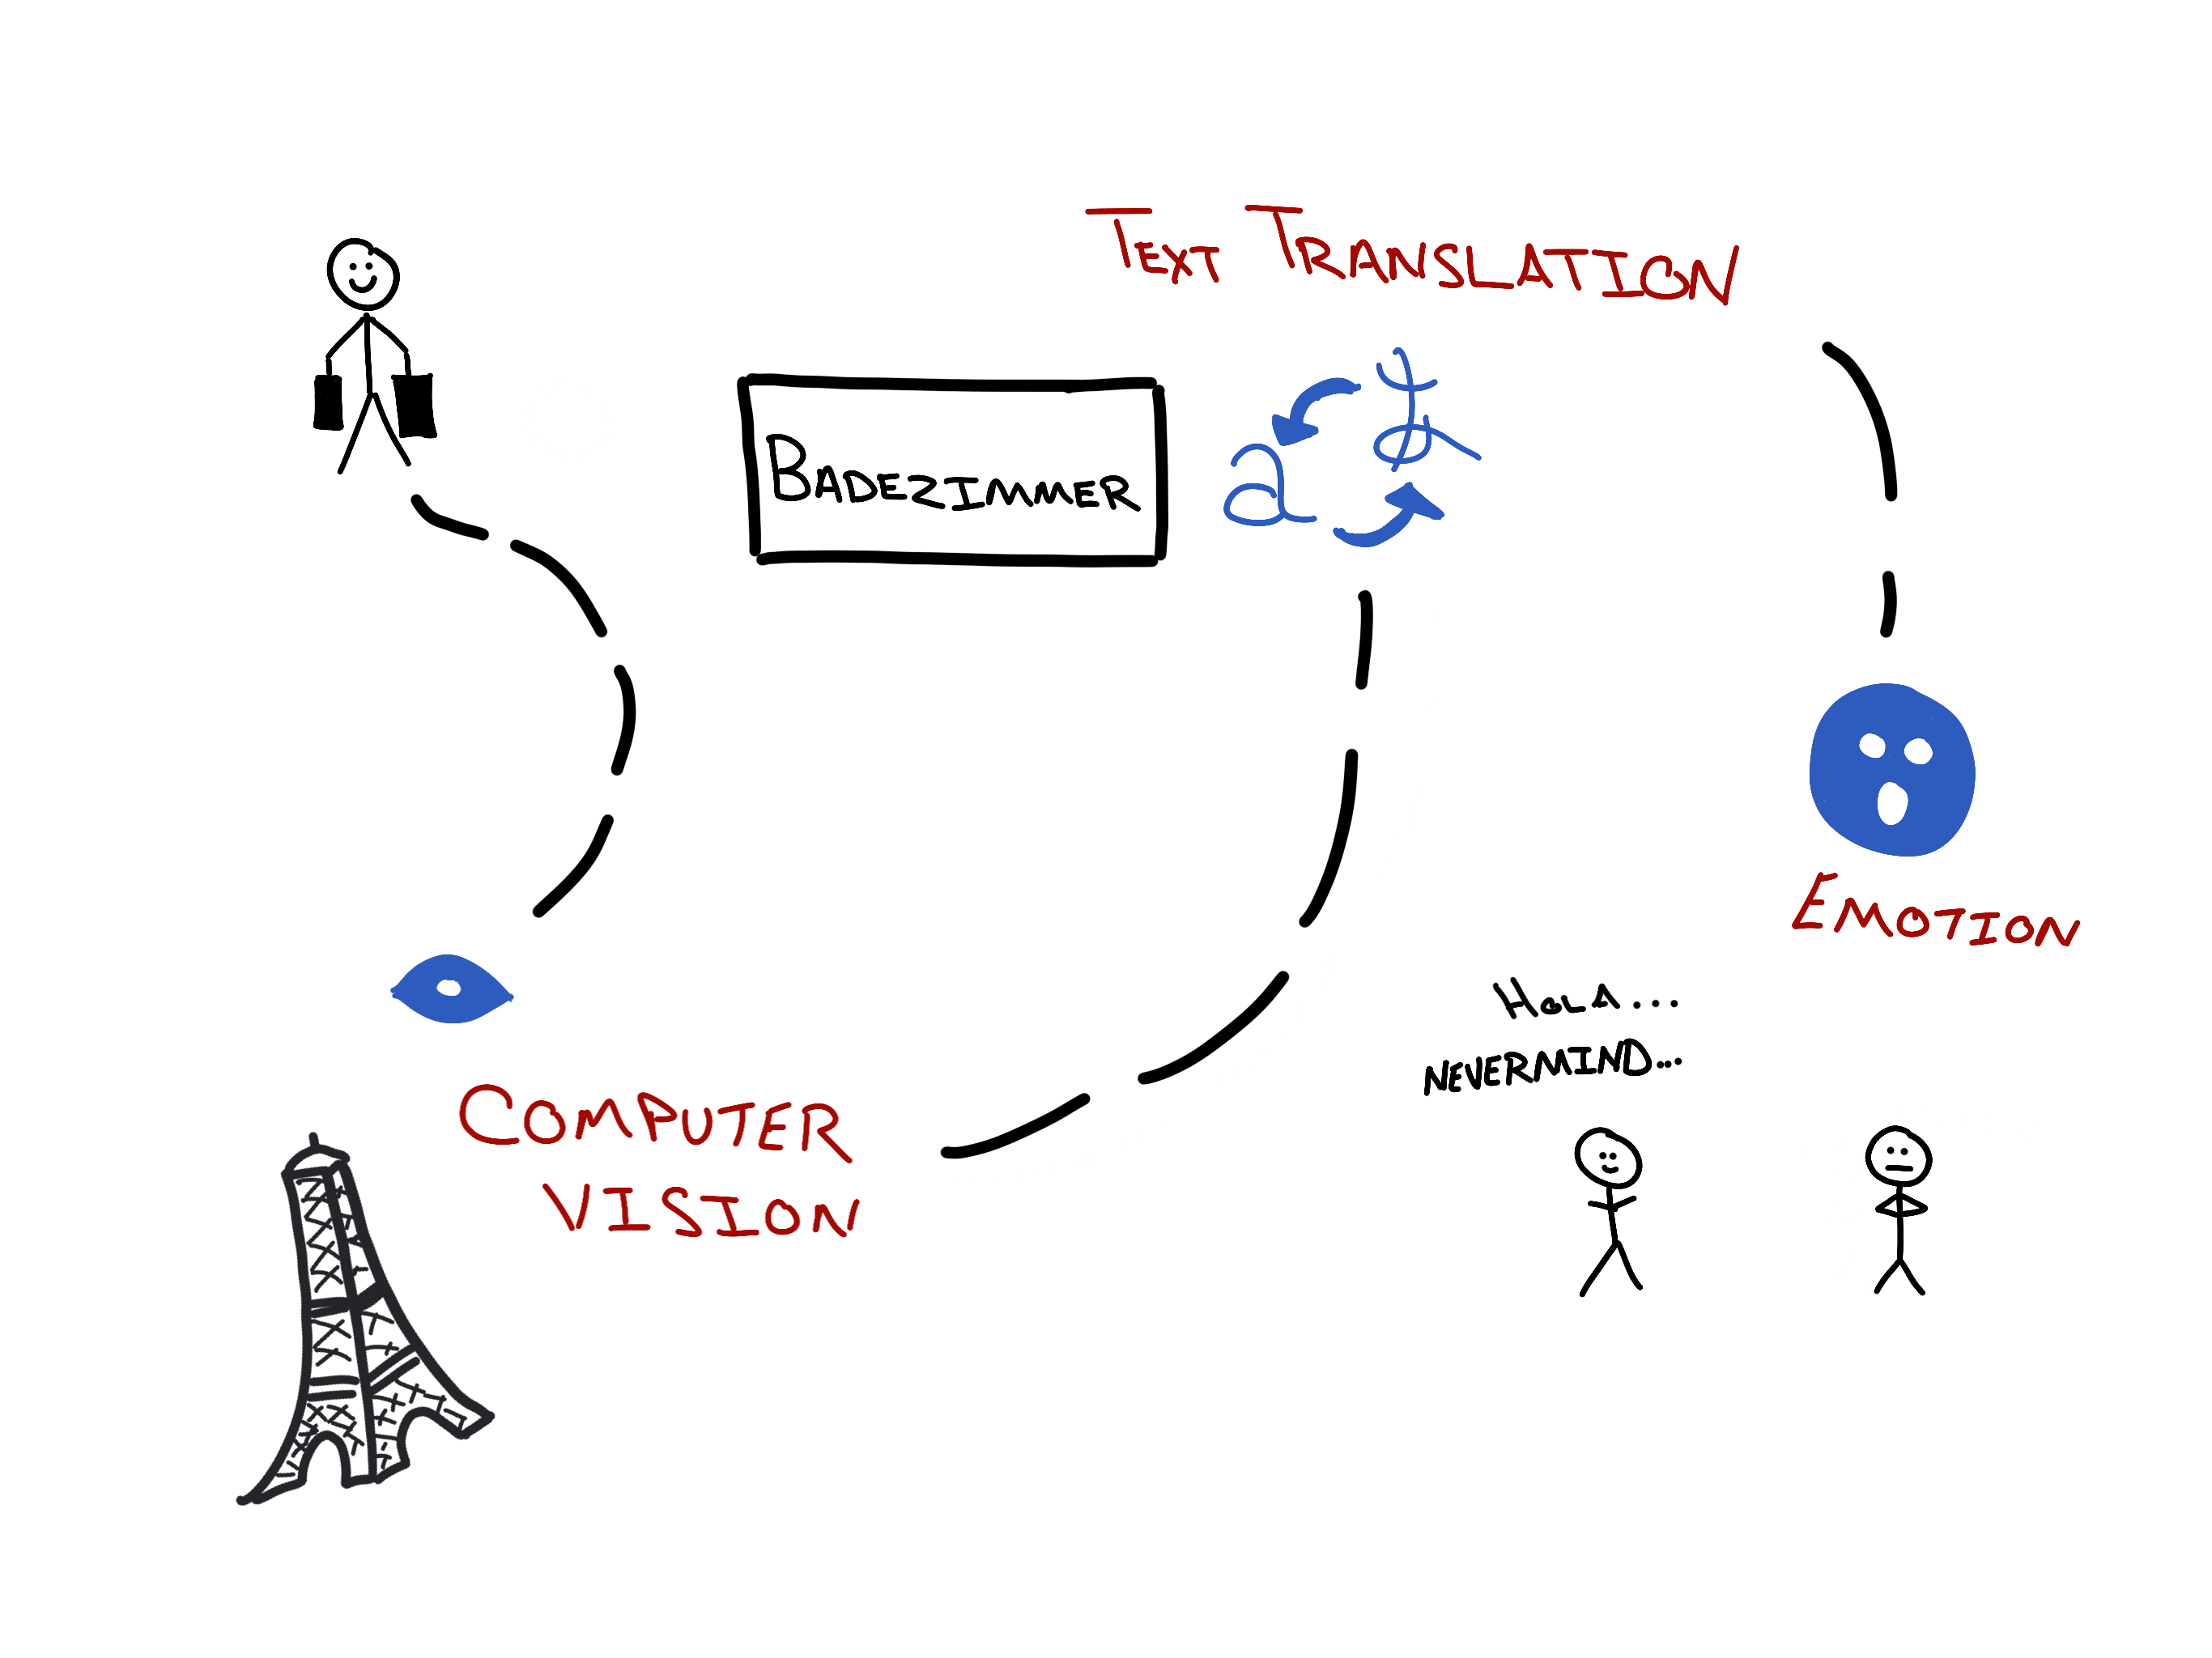
The Vacation Itinerary…

Slide 19

Computer Vision API
What’s in a photo??

Slide 20
Inspection Endpoints
Analyze
Recognize
Celebrities
Landmarks
Describe
Tag

Slide 21
Analyze - POST
https://api.cognitive.microsoft.com/vision/v1.0/
analyze
[?visualFeatures]
[&details]
Visual Features
Details
Body
Categories
Tags
Description
Faces
ImageType
Color
Adult
Celebrity
Landmark
URL to image
Binary of image

Slide 22
Analyze – return values
Description
Tags
Category array
Tags array
Faces array
Adult score
Color
Metadata
ImageType

Slide 23
Description…
Full sentences
Person laying on the beach
Notes:
Mention it will include percentages

Slide 24
Categories array…
86 predefined
Outdoor->Ocean/Beach
Outdoor->Water
Scene->Sky->Sun
Object->Plant->Tree
People

Slide 25
Tags array…
Sunny
Outside
Tree
Person
Water
Notes:
Mention it will include percentages

Slide 26
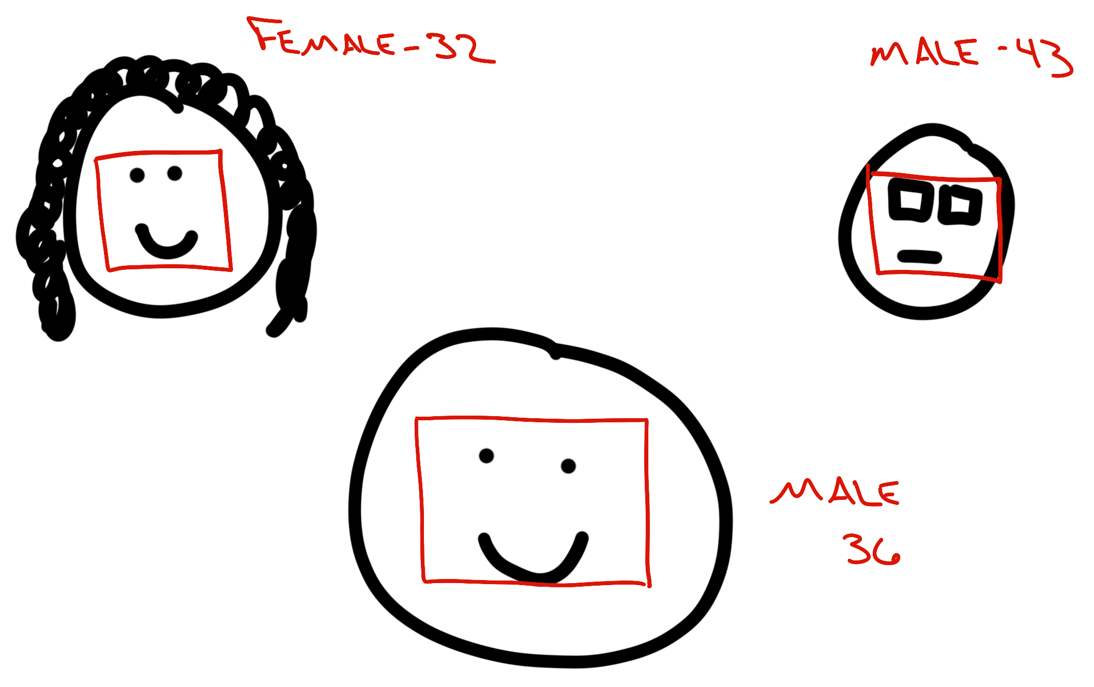
Faces array…
Up to 64 faces
Gender
Age
Coordinates in image

Slide 27
Describe & Tag - POST
https://api.cognitive.microsoft.com/vision/v1.0/describe[?maxCandidates]
https://api.cognitive.microsoft.com/vision/v1.0/tag
Body
URL to image
Binary of image

Slide 28

OCR endpoint
Recognize text in images
Including handwritten
Corrects rotation
Reads blocks
Separately
Notes:
Mention it will include percentages

Slide 29
Thumbnails
Create thumbnails
Specify height & width
Automatically detects ”region of interest”

Slide 30


Slide 31
The Vacation Itinerary…
Analyze
OCR
Thumbnails

Slide 32
The Vacation Itinerary…

Slide 33

Translator API
The multilingual machine…

Slide 34
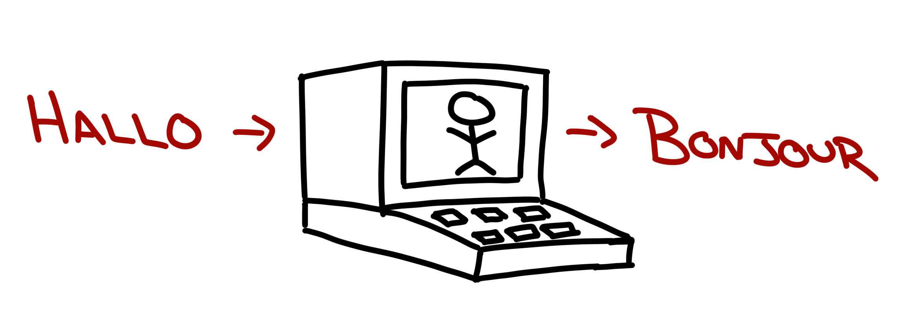
Translate text…

Slide 35
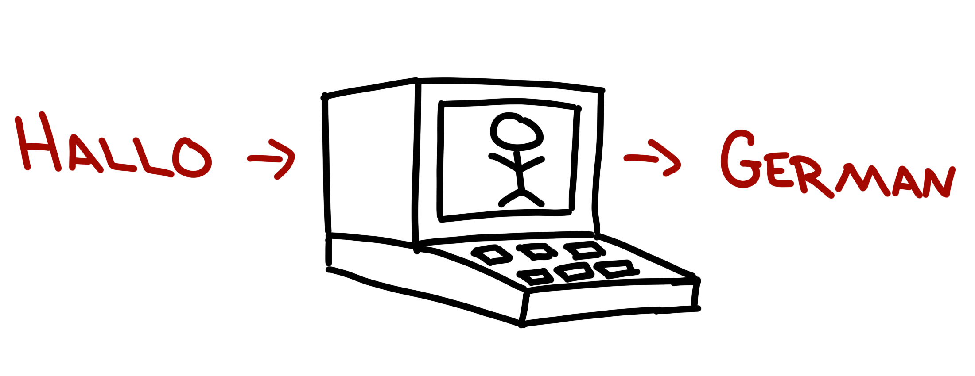
Detect language…

Slide 36

Speak!!!

Slide 38
The Vacation Itinerary…
Translate
Detect
Speak

Slide 39
The Vacation Itinerary…

Slide 40

Emotion API
The feeling cloud…

Slide 41

Score emotions in photos

Slide 42
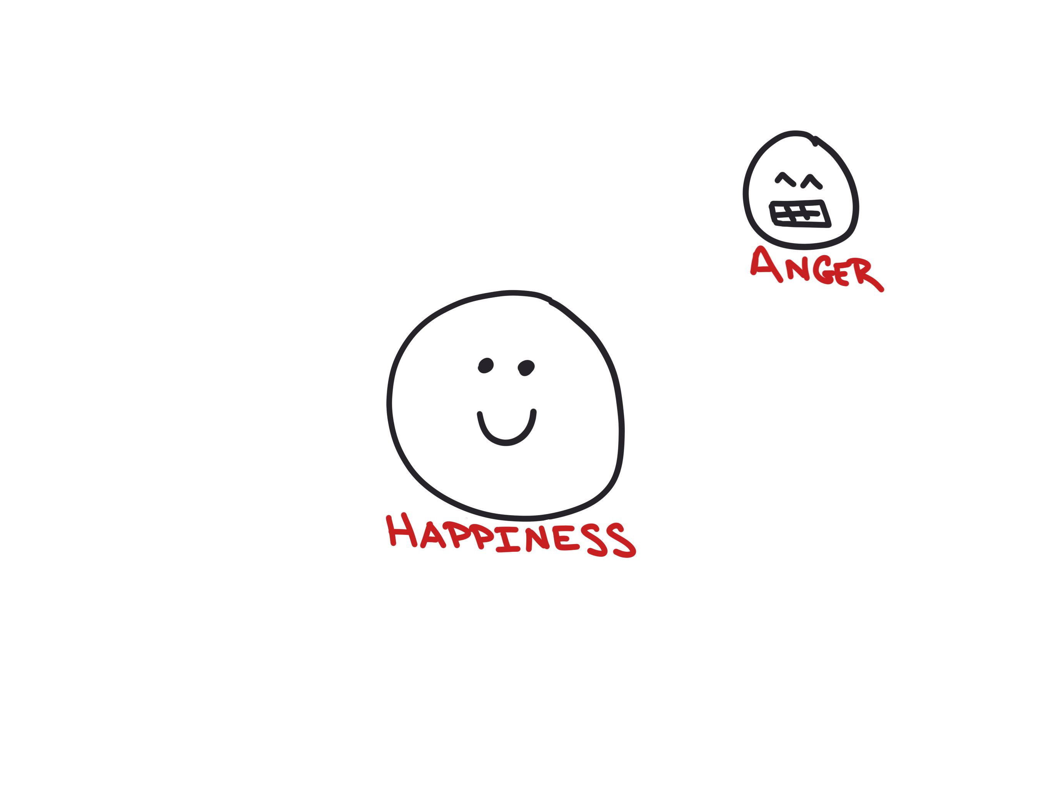
Score emotions in photos

Slide 43
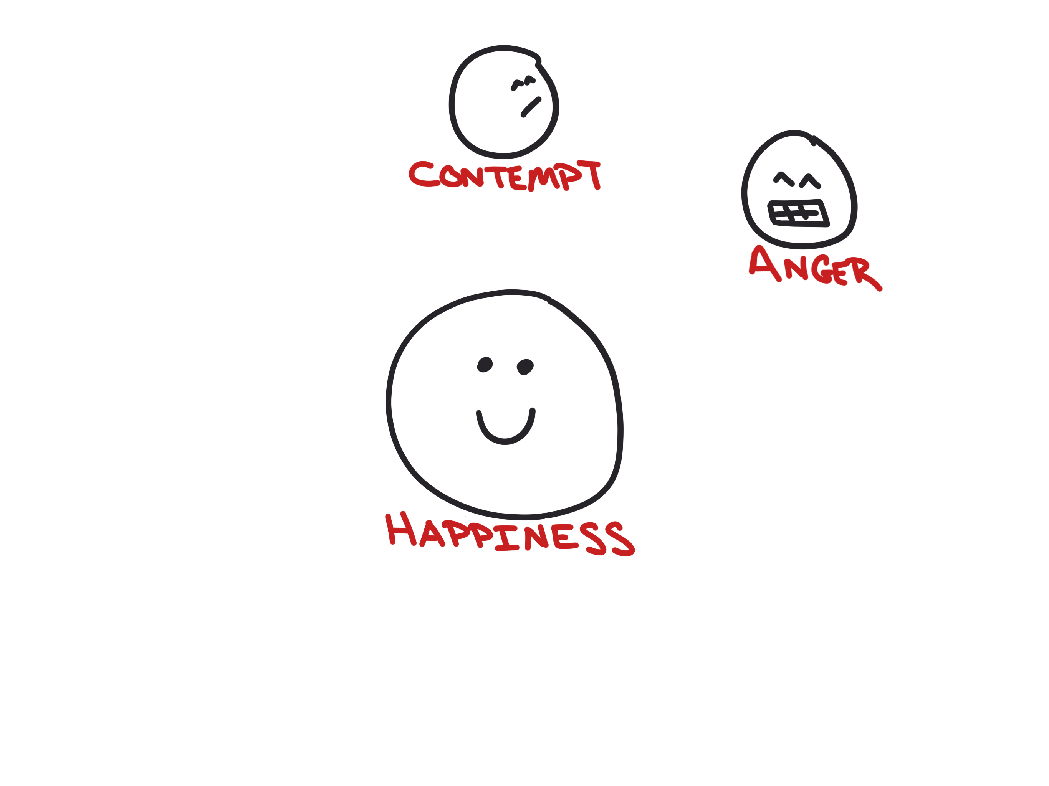
Score emotions in photos

Slide 44
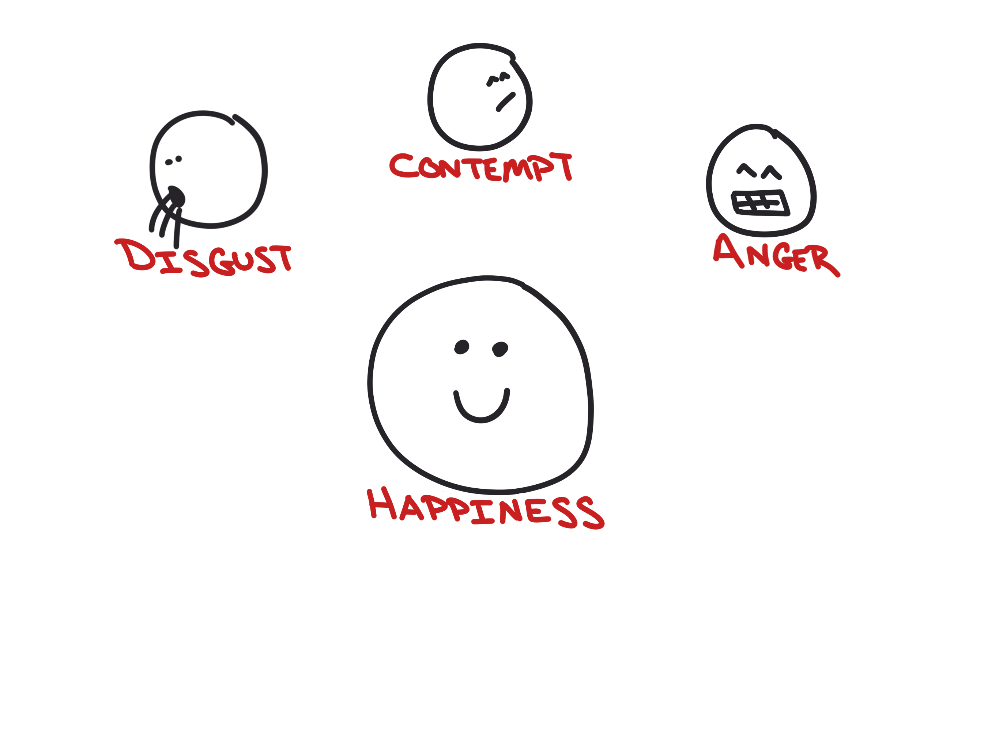
Score emotions in photos

Slide 45
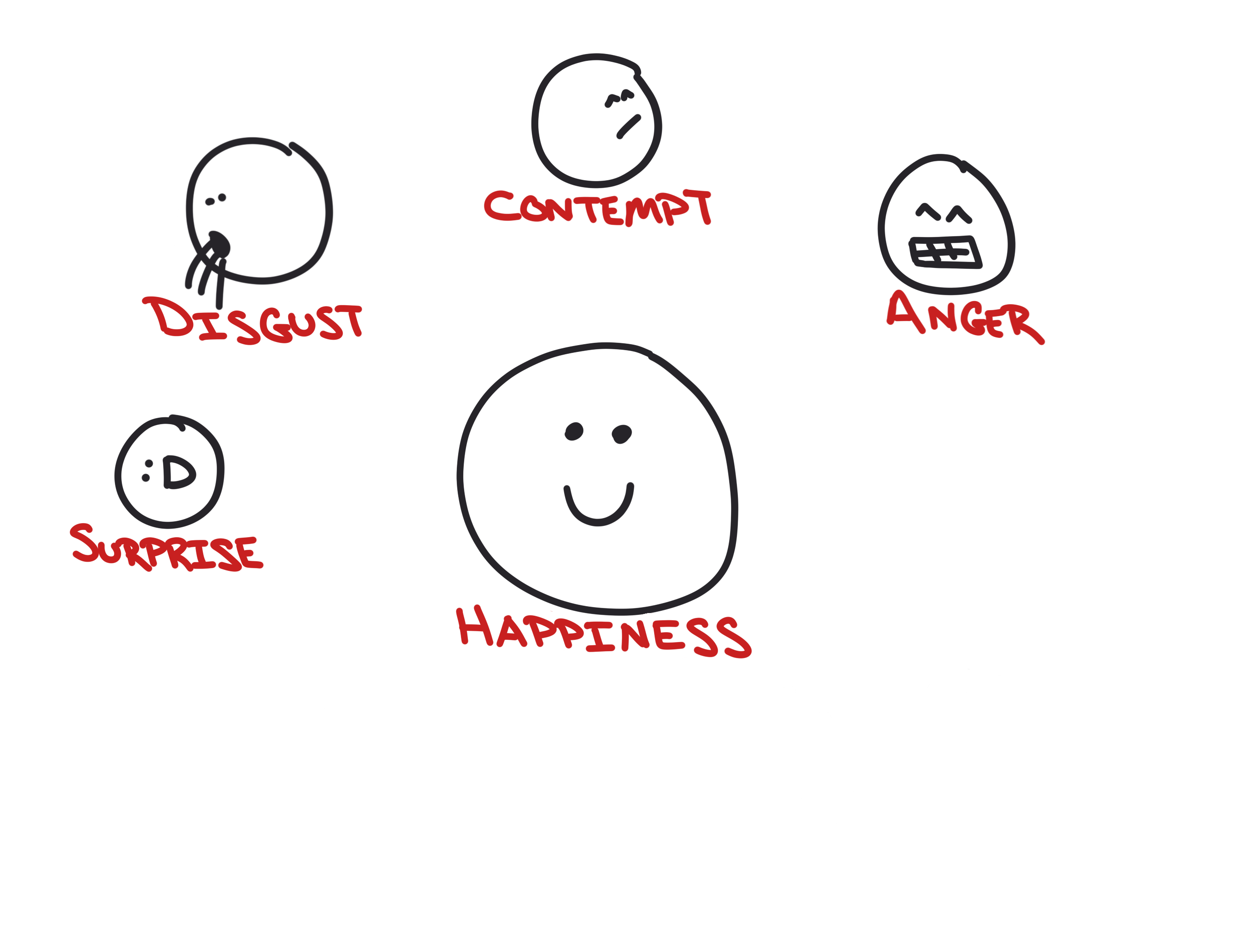
Score emotions in photos

Slide 46
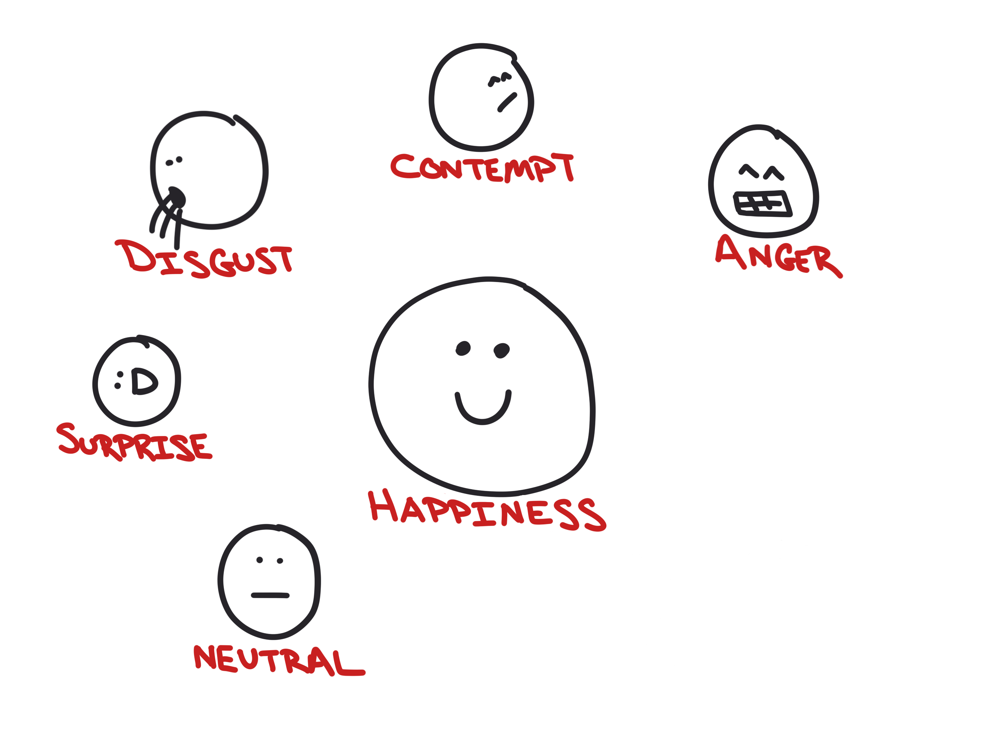
Score emotions in photos

Slide 47
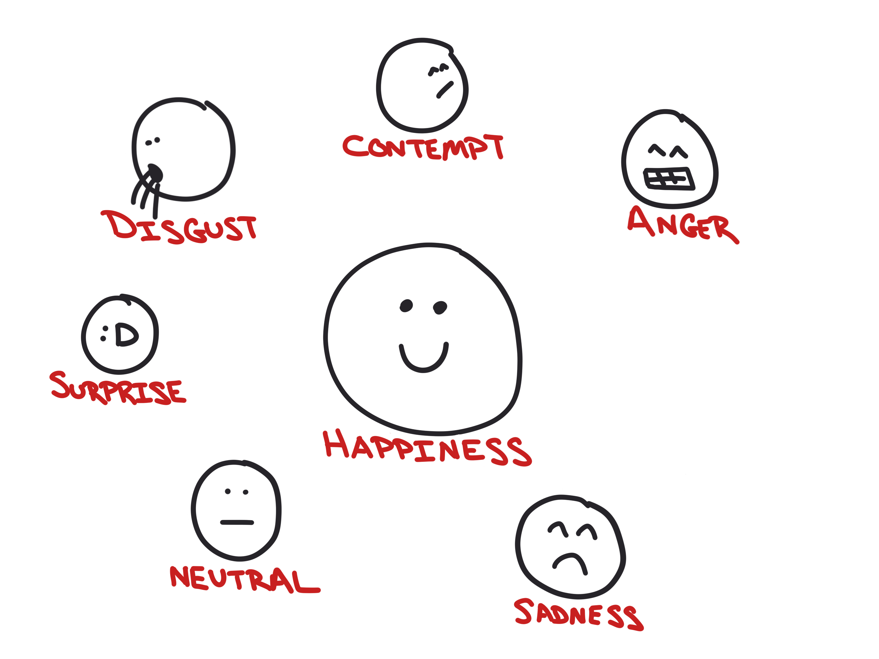
Score emotions in photos

Slide 48
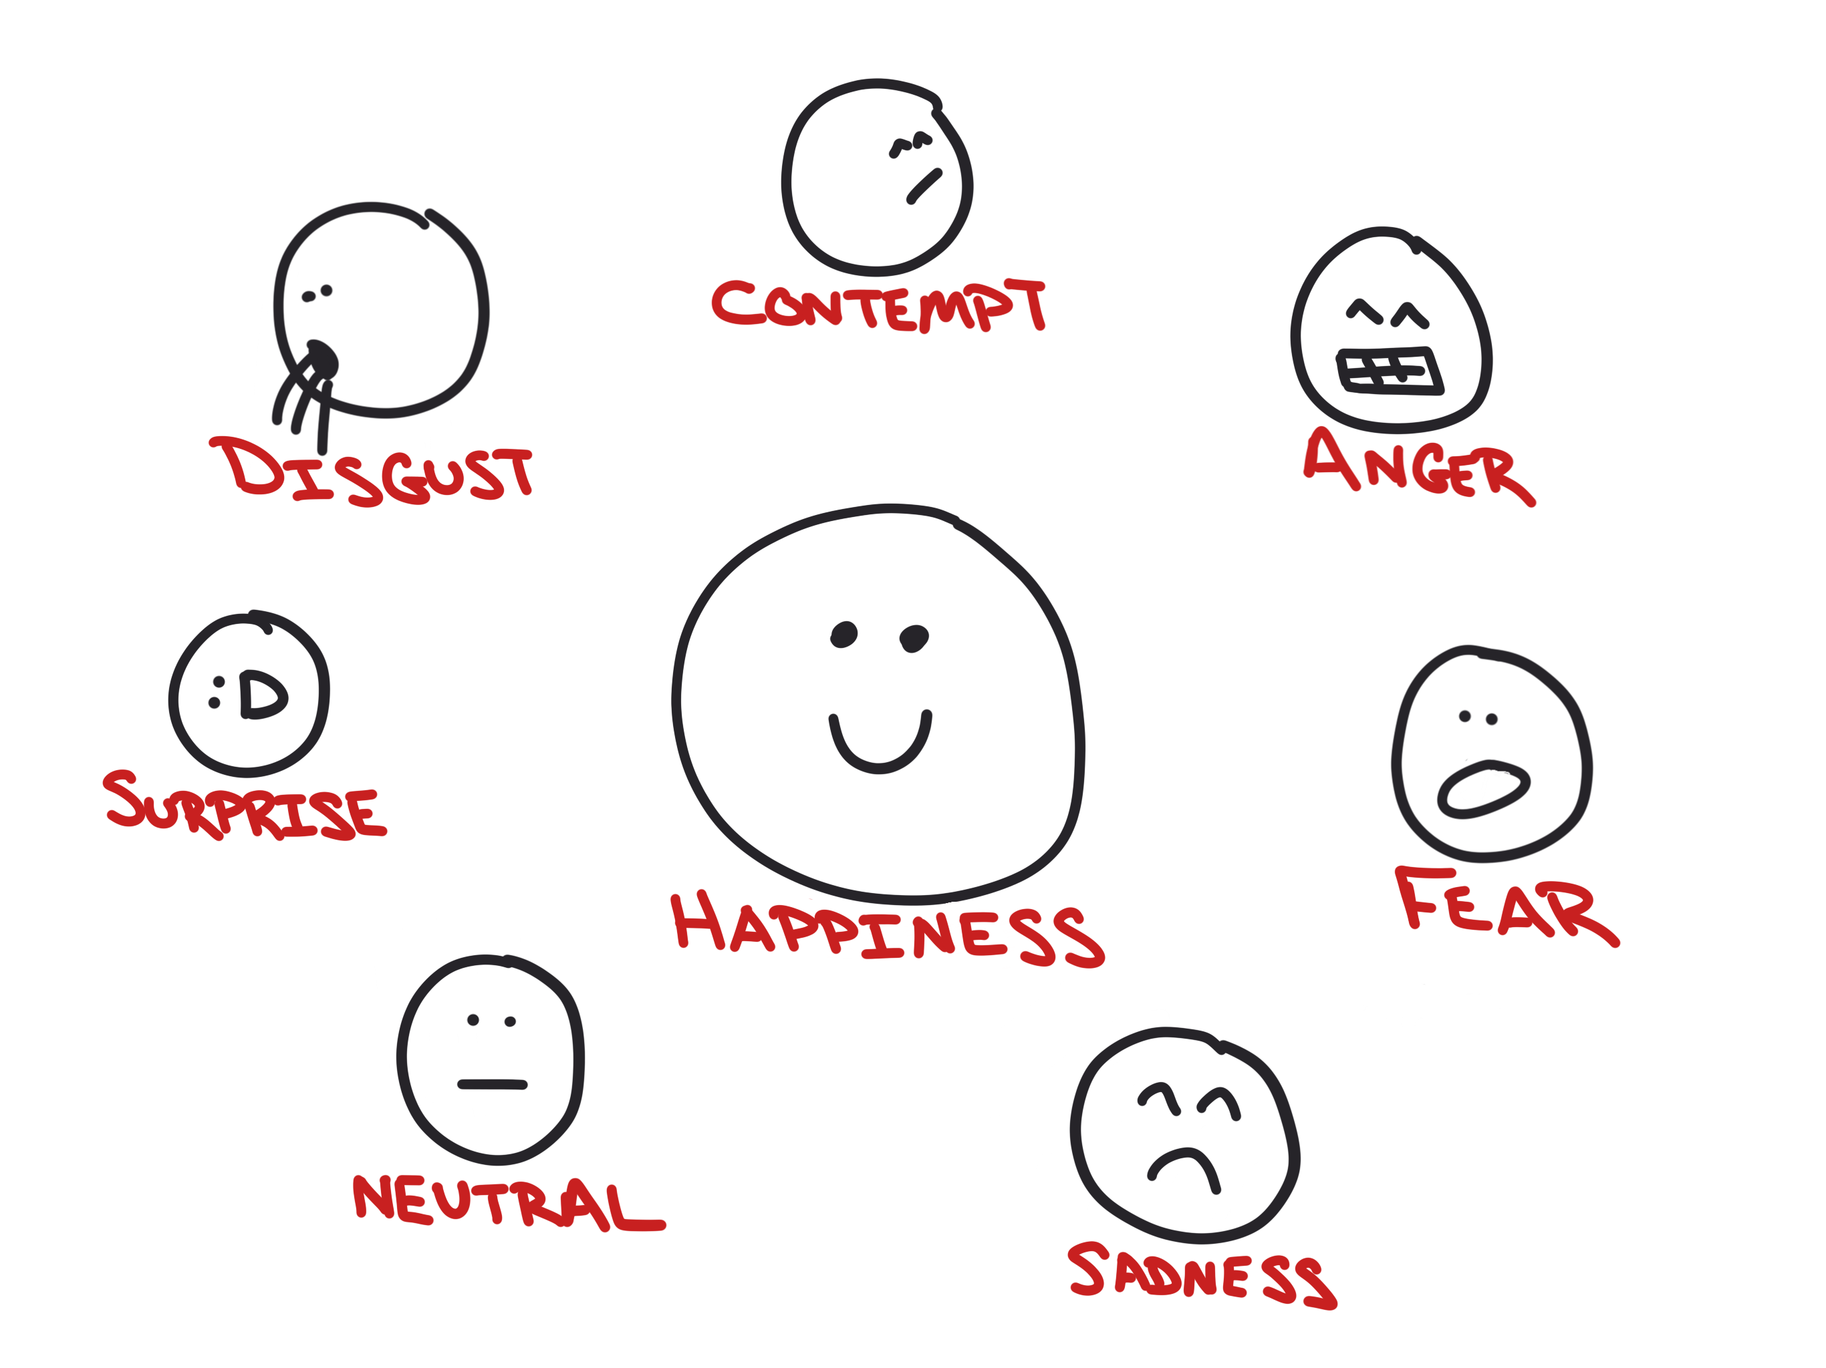
Score emotions in photos

Slide 50
The Vacation Itinerary…

Slide 51
Cognitive Services
Hosted in Azure
Machine learning
REST APIs

Slide 52
Lots of them…

Slide 53
Vision and OCR

Slide 54
Translation…

Slide 55
Emotions…

Slide 56


Slide 57
Making Apps More Human
AN INTRO TO MICROSOFT’S COGNITIVE SERVICES
Matthew Soucoup
PRINCIPAL
@codemillmatt codemilltech.com
@codemillmatt codemilltech.com
https://bit.ly/that-cog
Headshot optional

